Slide 1
Operations Management
William J. Stevenson
8th edition

Slide 2
CHAPTER
8
Location Planning
and Analysis
Operations Management, Eighth Edition, by William J. Stevenson
Copyright © 2005 by The McGraw-Hill Companies, Inc. All rights reserved.
McGraw-Hill/Irwin

Slide 3
Need for Location Decisions
Marketing Strategy
Cost of Doing Business
Growth
Depletion of Resources
Example-
Tata Nano West Bengal ( Political/sentimental) then relocated to Gujarat. Diff govt gives attractive tax benefit to woo business. HZL shifted last part of process to Uttarakhand 10 years tax holiday.
Mining companies as per resource available.( Tata steel/ coal india, HZL, Nalco SAIL)/port based/import based/ SEZ companies/ govt taxation/ bangalore-software hub.
Maruti at manesar due to transportation hub. Plants put on shore if more export/import involved.

Slide 4
Nature of Location Decisions
Strategic Importance
  Long term commitment/costs
  Impact on investments, revenues, and operations
  Supply chains
Objectives
  Profit potential
  Depends on where a business is in the supply chain.
  Identify several locations from which to choose
Options
  Expand existing facilities
  Add new facilities
  Move

Slide 5
Making Location Decisions
Decide on the criteria
Identify the important factors
Develop location alternatives
Evaluate the alternatives
Make selection

Slide 6


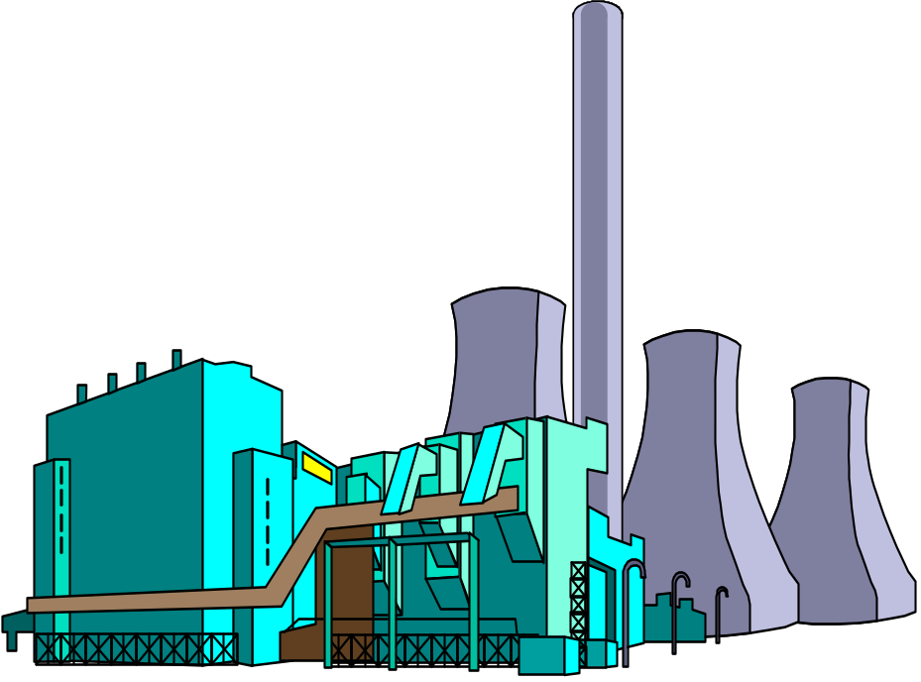

Location Decision Factors
Community
Considerations
Regional Factors
Multiple Plant
Strategies
Site-related
Factors

Slide 7
Regional Factors
Location of raw materials
Location of markets
Labor factors
Climate and taxes

Slide 8
Community Considerations
Quality of life
Services
Attitudes
Taxes
Environmental regulations
Utilities
Developer support

Slide 9
Site Related Factors
Land
Transportation
Environmental
Legal

Slide 10
Multiple Plant Strategies
Product plant strategy
Market area plant strategy
Process plant strategy

Slide 11
Comparison of Service and
Manufacturing Considerations
Table 8.2
Manufacturing/Distribution | Service/Retail
Cost Focus | Revenue focus
Transportation modes/costs | Demographics: age,income,etc
Energy availability, costs | Population/drawing area
Labor cost/availability/skills | Competition
Building/leasing costs | Traffic volume/patterns
 | Customer access/parking

Slide 12
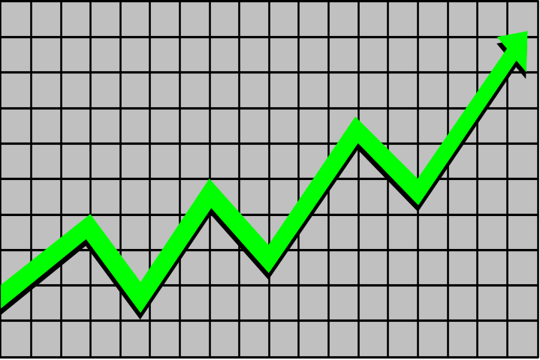
Trends in Locations
Foreign producers locating in U.S.
  “Made in USA”
  Currency fluctuations
Just-in-time manufacturing techniques
Microfactories
Information Technology

Slide 13
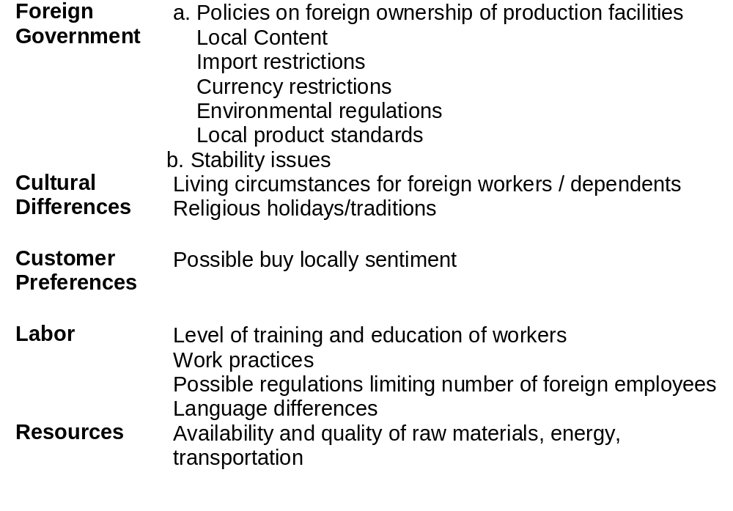
Table 8.3

Slide 14

Evaluating Locations
Cost-Profit-Volume Analysis
  Determine fixed and variable costs
  Plot total costs
  Determine lowest total costs

Slide 15
Location Cost-Volume Analysis
Assumptions
  Fixed costs are constant
  Variable costs are linear
  Output can be closely estimated
  Only one product involved

Slide 16
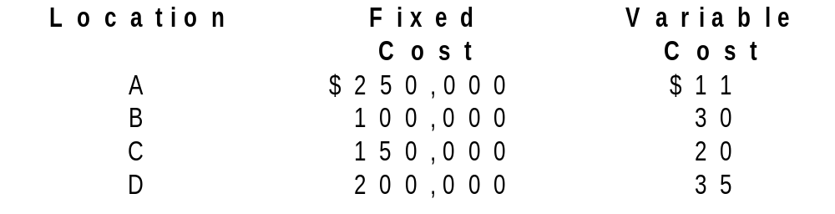
Example 1: Cost-Volume Analysis
Fixed and variable costs for
four potential locations

Slide 17
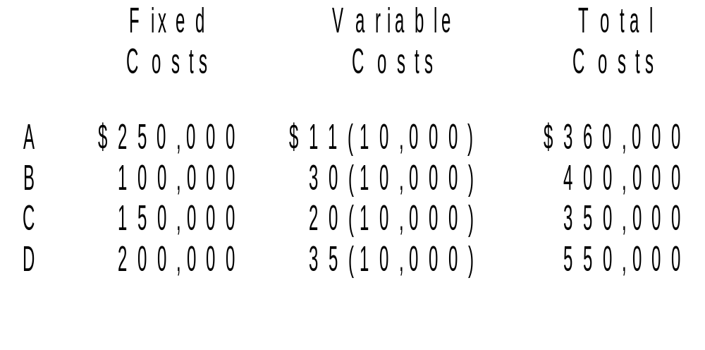
Example 1: Solution

Slide 18
Example 1: Solution
$(000)
800
700
600
500
400
300
200
100
0
D
B
C
A
A Superior
C Superior
B Superior
0
2
4
6
8
10
12
14
16
Annual Output (000)

Slide 19
Evaluating Locations
Transportation Model
  Decision based on movement costs of raw materials or finished goods
Factor Rating
  Decision based on quantitative and qualitative inputs
Center of Gravity Method
  Decision based on minimum distribution costs

